Slide 1




Optimization with Constraint Learning LAB
Part I
Speakers: Ilker Birbil & Donato Maragno
University of Amsterdam
February 7, 2023

Slide 2

Agenda
Introduction to Constraint Learning
Chemotherapy case study
Embedding Decision trees
Embedding Neural networks
Trust region constraints
Hands-on tutorial
Donato Maragno
Optimization with Constraint Learning LAB – Part I
2

Slide 3
Constraint Learning
Mixed-Integer Optimization (MIO)
Powerful tool that allows us to optimize a given objective subject to various constraints.
Many real-life optimization problems contain one or more constraints or objectives for which there are no explicit formulae.
Machine Learning (ML)
Data is available and machine learning models can be used to learn the constraints.
Donato Maragno
Optimization with Constraint Learning LAB – Part I
3

Slide 4
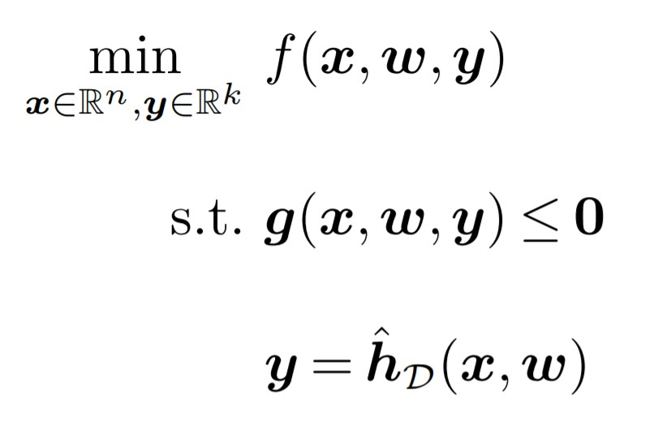
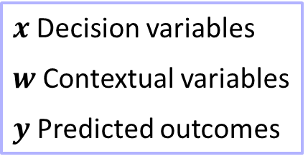
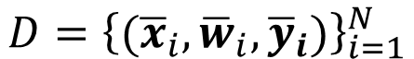
Constraint Learning
$x$Decision variables
$w$Contextual variables
$y$Predicted outcomes
$$D={\left\{({\overline{x}}_{i},{\overline{w}}_{i},{\overline{y}}_{i})\right\}}_{i=1}^{N}$$
Donato Maragno
Optimization with Constraint Learning LAB – Part I
4

Slide 5
Constraint Learning
$x$Decision variables
$w$Contextual variables
$y$Predicted outcomes
$$D={\left\{({\overline{x}}_{i},{\overline{w}}_{i},{\overline{y}}_{i})\right\}}_{i=1}^{N}$$
Donato Maragno
Optimization with Constraint Learning LAB – Part I
4

Slide 6

Constraint Learning
$x$Decision variables
$w$Contextual variables
$y$Predicted outcomes
$$D={\left\{({\overline{x}}_{i},{\overline{w}}_{i},{\overline{y}}_{i})\right\}}_{i=1}^{N}$$
Donato Maragno
Optimization with Constraint Learning LAB – Part I
4

Slide 7

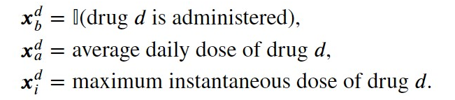
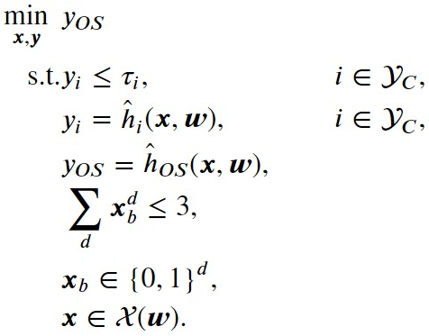
Chemotherapy Case Study
Case Study: Diet Problem
In this case study, we extend the work of Bertsimas et al. (2016)* in the design of chemotherapy regimens for advanced gastric cancer. Given a new study cohort and study characteristics, we would like to optimize a chemotherapy regimen to maximize the cohort’s survival subject to constraint on different types of toxicity.
Overall Survival
Toxicities
Grade 3/4 constitutional
Infection
Neurological
Grade 4 blood
…
Cohort contextual variables
Gender
Age
primary site breakdown
ecog score
…
(*) Bertsimas D, O’Hair A, Relyea S, Silberholz J (2016) An analytics approach to designing combination chemotherapy regimens for cancer. Management Science 62(5):1511–1531, ISSN 15265501
Donato Maragno
Optimization with Constraint Learning LAB – Part I
5

Slide 8
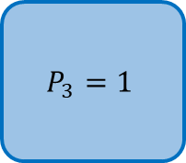
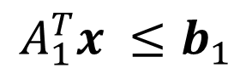
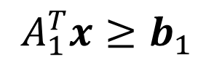
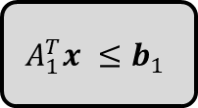
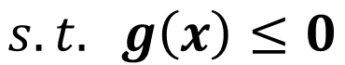
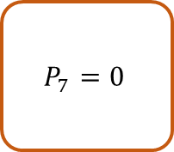
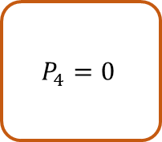
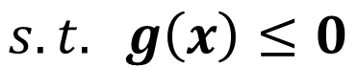
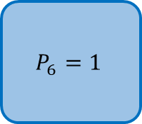
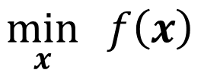
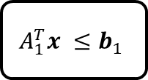
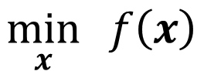
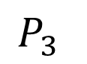
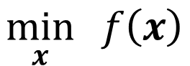
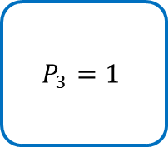
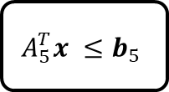

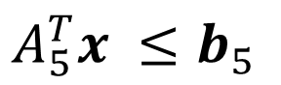

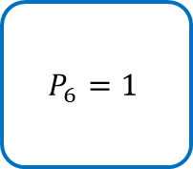
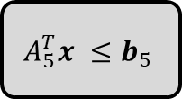
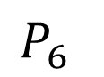
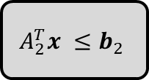
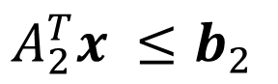
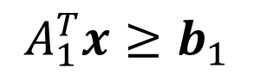



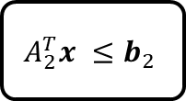
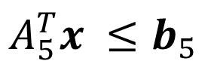
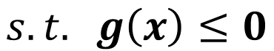


Embedding Decision Trees
$$\min_{x}{ f\left(x\right)}$$
$$\min_{x}{ f\left(x\right)}$$
$$A_{1}^{T}x ≤b_{1}$$
Conceptual model
$$s.t. g\left(x\right)≤0$$
$$A_{1}^{T}x ≤b_{1}$$
$$A_{1}^{T}x ≤b_{1}$$
$$s.t. g\left(x\right)≤0$$
False
$$A_{1}^{T}x ≤b_{1}$$
False
True
False
True
True
$$A_{2}^{T}x ≤b_{2}$$
$$A_{5}^{T}x ≤b_{5}$$
$$A_{2}^{T}x ≤b_{2}$$
$$A_{2}^{T}x ≤b_{2}$$
$$A_{2}^{T}x ≤b_{2}$$
$$A_{5}^{T}x ≤b_{5}$$
$$A_{5}^{T}x ≤b_{5}$$
$$A_{1}^{T}x ≤b_{1}$$
$$P_{3}$$
True
False
True
False
Learned constraints
$$A_{2}^{T}x ≤b_{2}$$
True
True
False
False
True
True
False
False
$$\min_{x}{ f\left(x\right)}$$
$$P_{4}=0$$
$$P_{4}=0$$
$$P_{3}=1$$
$$P_{4}=0$$
$$P_{7}=0$$
$$P_{7}=0$$
$$P_{3}=1$$
$$P_{7}=0$$
$$P_{3}=1$$
$$P_{6}=1$$
$$P_{6}=1$$
$$P_{6}=1$$
$$A_{1}^{T}x≥b_{1}$$
$$P_{6}$$
$$s.t. g\left(x\right)≤0$$
$$A_{5}^{T}x ≤b_{5}$$
$$A_{1}^{T}x≥b_{1}$$
$$A_{5}^{T}x ≤b_{5}$$
Donato Maragno
Optimization with Constraint Learning LAB – Part I
6

Slide 9
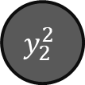
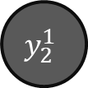

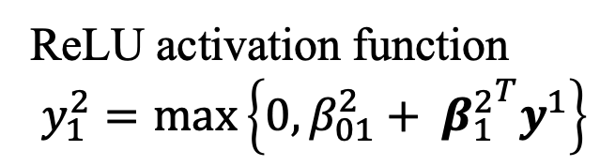
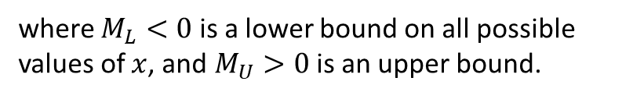

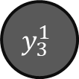
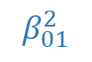
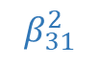
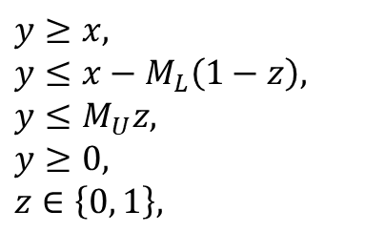



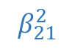

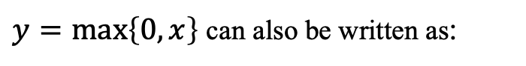

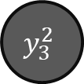
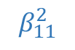
Embedding Neural Networks
ReLU activation function
$$y_{1}^{2}=\max\left\{0,β_{01}^{2}+ {β_{1}^{2}}^{T}y^{1}\right\}$$
$$β_{01}^{2}$$
$$y_{2}^{1}$$
$$β_{11}^{2}$$
$$y_{2}^{1}$$
$$y_{1}^{2}$$
$$x_{1}$$
$$y_{1}^{2}$$
$$x_{1}$$
$y=\max\left\{0,x\right\}$ can also be written as:
$$β_{21}^{2}$$
$$y≥x,$$
$$y≤x−M_{L}\left(1−z\right),$$
$$y≤M_{U}z,$$
$$y≥0,$$
$$z∈\left\{0, 1\right\},$$
$$y_{2}^{1}$$
$$y_{2}^{1}$$
$$y_{2}^{2}$$
$$y_{2}^{2}$$
$$Σ$$
$$x_{2}$$
$$Σ$$
$$x_{2}$$
$$β_{31}^{2}$$
$$y_{3}^{1}$$
$$y_{3}^{1}$$
$$y_{3}^{2}$$
$$x_{n}$$
$$y_{3}^{2}$$
$$x_{n}$$
where $M_{L}<0$ is a lower bound on all possible values of $x$, and $M_{U}>0$ is an upper bound.
Donato Maragno
Optimization with Constraint Learning LAB – Part I
7

Slide 10
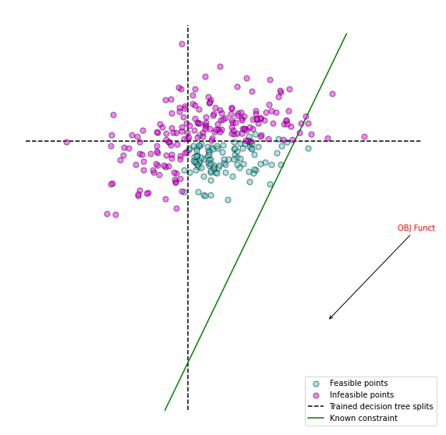
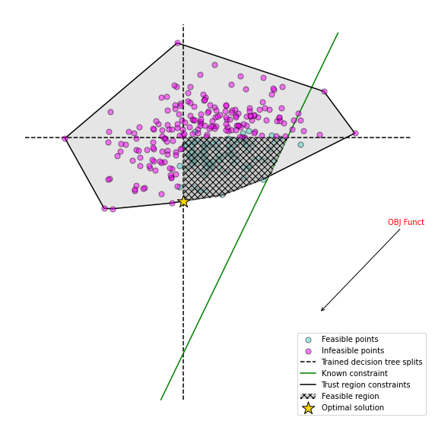
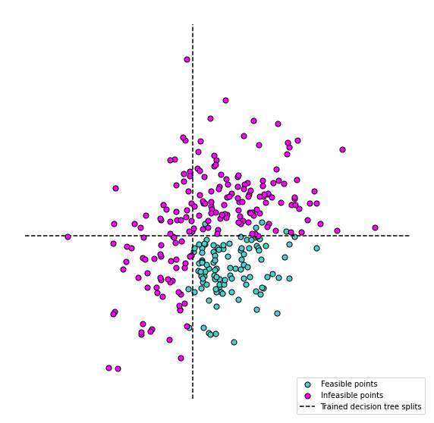
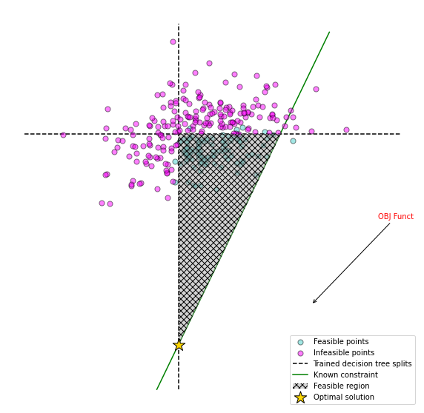
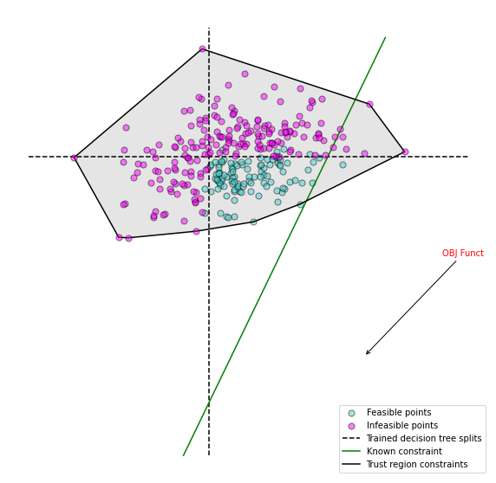

Trust region constraints
$$CH\left(x\right)= \left\{x|x=\sum_{i}^{N}{λ_{i}{\overline{x}}_{i}}, \sum_{i}^{N}{λ_{i}=1}, λ_{i}≥0, i=1,…, N\right\}$$
Donato Maragno
Optimization with Constraint Learning LAB – Part I
8

Slide 11




OptiCL
A Python Package for
Optimization with Constraint Learning
https://github.com/hwiberg/OptiCL
Hands-on tutorial on the diet problem
Donato Maragno
Optimization with Constraint Learning LAB – Part I
9

Slide 12








Thank you!
Q&A
CONTACT ME
d.maragno@uva.nl
github.com/donato-maragno
@MaragnoDonato
linkedin.com/in/donato-maragno

